Slide 1
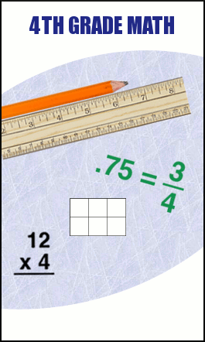
Mr. Sokol’s 4th Grade Math and Social Studies Class Room 303

Slide 2
Who is Mr. Sokol?
Received Bachelors and Master of Education degree from Ohio State
First Year Taught 5th Grade Gifted Math and Social Studies at North
Last 2 Years Taught 7th Grade Social Studies at Central
Coached 7th Grade Boys Basketball
Buckeyes and Bengals Football Fan, Dayton Flyer Basketball Fan
4th Year Teaching

Slide 3
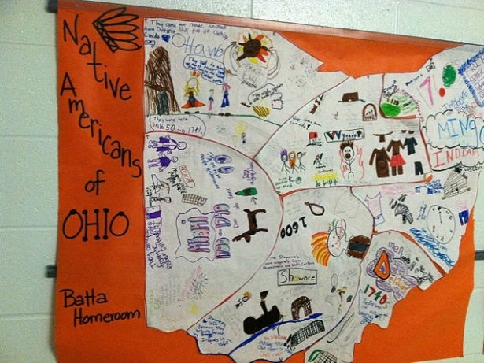
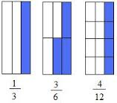
What will I be doing this year?

Slide 4
Why we have rules and procedures …
Keep us safe
Save time
Making sure learning is happen
Feel comfortable
Stop interruptions
LEARNING
LEARNING
LEARNING

Slide 5
Mr. Sokol’s Classroom Rules
1. Listen and follow directions.
2. Raise your hand silently and receive permission before speaking or leaving your seat.
3. Keep your hands, feet, and objects to yourself.
4. Respect your classmates and your teacher.
5. Work quietly and do not disturb others.
6. Sit in your assigned seat.

Slide 6
Consequences For Breaking a Rule
1st Offense: Warning
2nd Offense Move Down Clip Chart – Yellow – 5 Minutes Off Recess
3rd Offense – Blue – 10 Minutes Off Recess
4th Offense – Red – Loss of Recess/Parent Contact
5th Offense – Office Referral

Slide 7
Consequences For Positive Behavior or Following the Rules
1st Time – Pink - Move higher up the clip chart
2nd Time – Black - Move higher up the clip chart
3rd Time – Purple – Prize At The End of The Day/Positive Parent Contact
4th Time – Principal’s Office For Positive Reward

Slide 8
Morning Routine Procedure
Enter class without talking (Champs Level 0)
Remove coat, bookbag and hang up
Put away electronics
Sign in with lunch count on smartboard
Have sharpened pencil, textbook, and any other materials ready
Begin working silently (Champs Level 0)on morning work
Be silent (Champs Level 0) and listen to the announcements

Slide 9
How To Enter The Classroom
Enter silently Level 0 No Talking (CHAMPS)
Get out homework, if any
Have materials ready (i.e. book, homework, pencils)
Begin working on Problem Of The Day (Math), Daily Geography (SS)

Slide 10
When I Need To Get Your Attention
I Say:
1, 2, 3, Eyes On Me
You Say:
1, 2, Eyes On You

Slide 11
When I Need To Get Your Attention(Continued)
Raise your hand and give me five with your hand
Be silent and look at the teacher
Dutta, Dutta….
Hornets!

Slide 12
Paper Headings
First and Last Name –
Student’s Number
Date
Assignment
Place this heading on all assignments and papers
Example –
Jane Doe #11
8/16
Getting To Know Me

Slide 13
Classroom Helpers
2 helpers
Rotates every week alphabetically by last name
Cleans board, passes out and collects whiteboard, passes out papers, takes things to office, sharpens dull pencils at the end of the day

Slide 14
Using Chromebooks
Your student number is the Chromebook number you will use
Please make sure to use these carefully
You are responsible for your Chromebook number
I will dismiss you by your Chromebook numbers to charge the Chromebooks

Slide 15
Using Whiteboards
We will use these daily in Math
The class helpers will pass out and collect whiteboards, expo markers and dry erasers

Slide 16
Exiting or Dismissing Class
1. Make sure your work area and desk is neat and clean
2. Homework/Behavior is noted
3. Stay seated until there is a signal to exit or I say have a nice day.
4. Push in or stack your chair(end of day) as you leave

Slide 17
Absent
Check the class calendar to see what we did
Check the missing work bin for the day you were absent
Write Absent on the assignment
Check class website

Slide 18
Hall Passes – Restroom, library, fountain
One person out of the room at a time
Go to restroom during breaks
No passes when I am teaching
Use the hall pass in your agenda

Slide 19
Replacing Dull or Broken Pencils
If your pencil breaks or needs sharpening, raise your hand and point to the pencil cups
I will then give you permission
Put dull or broken pencil in dull pencil cup
Take sharp pencil from sharp pencil cup and return to seat
End of day return pencil to dull pencil

Slide 20
How to turn in work
Keep passing papers all the way to the left

Slide 21
Getting the teacher’s attention or asking for help
Raise your hand and wait silently for the teacher to call on you or come to you
If after 1 minute I have not called on you or come to you, please make note of your question on a piece of paper

Slide 22
Friday Folders
Pass Back Graded Assignments on Friday
2 helpers will help pass back papers

Slide 23
Use of Materials and Supplies
Ask for permission to borrow any materials (i.e. tape, hole puncher, stapler)
Return any materials when you are finished
This shows respect

Slide 24
Lining Up and Hallway Procedures
1. Push in your chairs
2. Zip and flip – zip your lips and cross your arms in front of you
3. Remain Silent Level 0 as we walk to the destination in a single file line

Slide 25
Math Minutes
Students will be assigned a worksheet or be practicing math facts online
http://www.k5chalkbox.com/online-math-games.html
30 minutes
Must be signed by parent by Friday

Slide 26
Taking a Test
Be silent, even when you finish and others are taking the test
You may not return to the test once you have turned it in
Raise your hand when you are finished with the test or have a question
Keep your eyes on your own paper
Remain seated and begin working on the material the teacher has instructed

Slide 27
Consequences For Not Following Procedure on Test
Talking Or Being Disruptive Will Automatically Result in a Red on Clip Chart – Loss of Recess/Parent Contact and will result in having to take your test during recess

Slide 28
During Class
Follow the Champs Classroom Bulletin Board For Activities for Conversation, Help, Activity, Movement, Participation, Success

Slide 29
Emergency Drills
Lockdown
Fire Drill
Tornado Drill

Slide 30
Birthdays
When it is your birthday, I will give you a Happy Birthday Pencil!
The class can sing to you if you would like

Slide 31
I believe in your potential and I know that you all have the ability to succeed. Lets have a great year! Mr. Sokol

